Slide 1
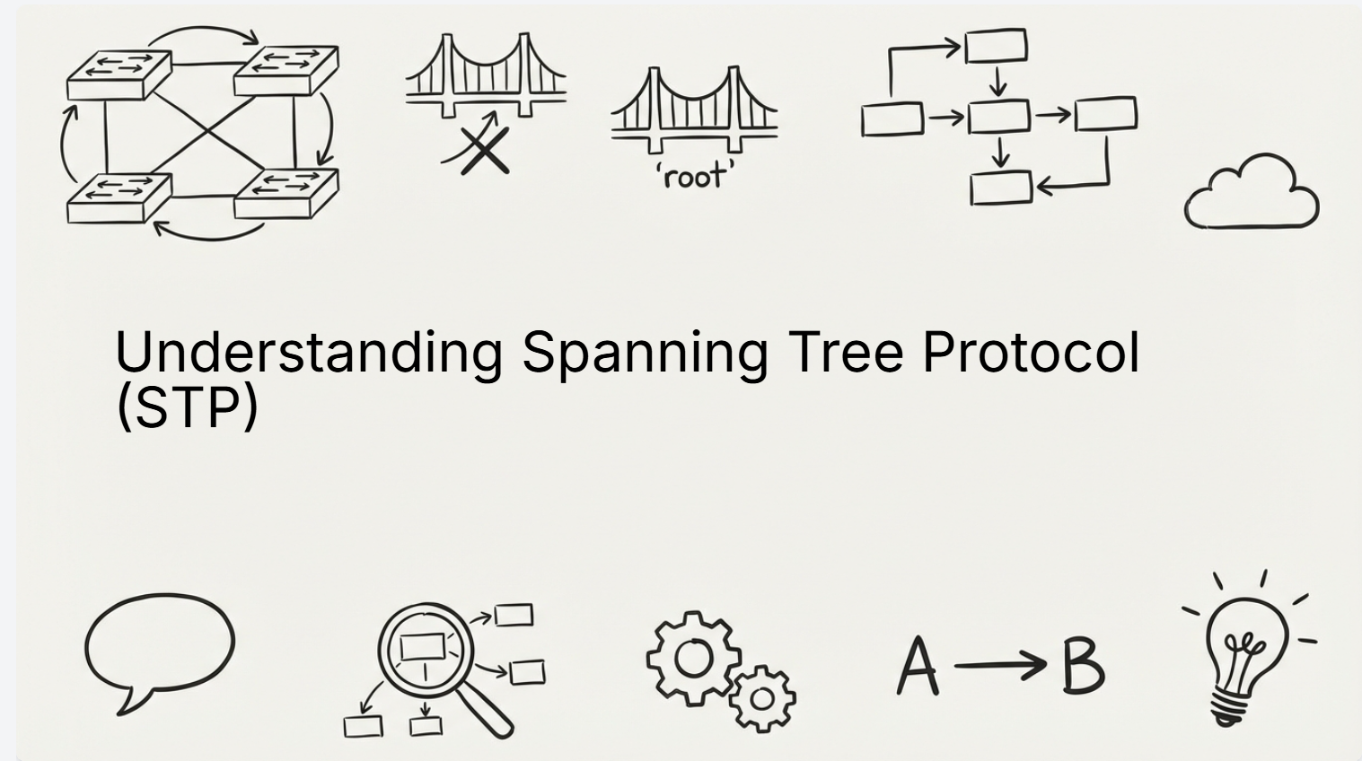

Slide 2
Agenda
What STP is and what it does
Bridge ID and Priority
Root Bridge election
STP port roles
How STP builds the tree
Walkthrough example topology
Why Layer-2 loops are dangerous

Slide 3
The Problem: Layer-2 Loops
Ethernet frames have no TTL
Redundant switch links create loops
Loops cause:
Broadcast storms
MAC address table instability
Network outage
STP exists to stop this.

Slide 4
What is STP
STP = Spanning Tree Protocol
IEEE 802.1D
Prevents Layer-2 loops
Keeps redundancy while avoiding storms
Blocks ports logically, not physically

Slide 5
How STP Works
1. Elects a Root Bridge
2. Calculates best paths to the root
3. Blocks redundant ports
All decisions are based on BPDUs.
STP performs three steps

Slide 6
STP Communication
Switches exchange BPDUs
BPDUs carry:
Root Bridge ID
Sender Bridge ID
Path cost
Lowest values always win

Slide 7
What is Bridge ID
Bridge ID = Priority + MAC Address
Priority:
Default: 32768
Lower is better
MAC Address:
Used only if priorities match
Lowest Bridge ID becomes Root Bridge.

Slide 8
STP Priority
Priority controls Root Bridge election
Valid values:
0, 4096, 8192, … 61440
Lower priority = higher chance to be root
Design rule:
Core switch should have the lowest priority.

Slide 9
Root Bridge
Only one Root Bridge per VLAN
Root Bridge characteristics:
No Root Port
All ports are Designated Ports
Root Bridge is the reference point for STP

Slide 10
STP Port Roles
Root Port (RP):
Best path toward Root Bridge
One per non-root switch
Designated Port (DP):
Best path away from Root Bridge
One per network segment
Blocked / Alternate Port:
Prevents loops
Does not forward traffic

Slide 11
Path Cost
STP chooses paths based on cost
Cost depends on link speed
Lower total cost = preferred path

Slide 12

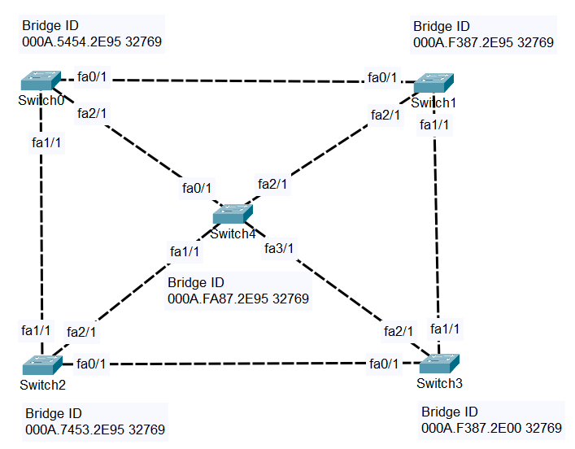


Slide 13
Thank you for watching
Wishing you the best

